Slide 1
Testis disorders
Dr.Alaa A. Ibrahim
University of Basrah \College of Veterinary Medicine Department of Veterinary Surgery and Obstitric

Slide 2
Disorders of the testes
Anorchism is the absence of both testicles. This condition is rare in small animals
Monorchism is the absence of one testicle. This condition is rare in small animals
Definitive diagnosis is obtained by careful ultrasonographic evaluation, computed tomography, magnetic resonance imaging, or exploratory abdominal surgery.

Slide 3
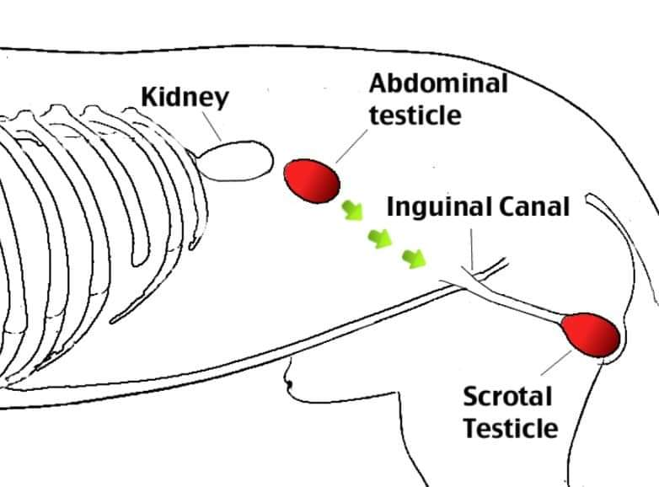
Cryptorchidism
Cryptorchidism is a condition in which one or both testicles do not descend into the scrotum
The testis originates on the caudal ridge of the kidney in the abdominal cavity of the fetus, passes through the inguinal canal, and descends into the scrotal cavity.
Testicular descent into the scrotum depends on the growth and action of the gubernaculum

Slide 4
Cryptorchidism is described by location (abdominal, inguinal, prescrotal), side (right, left), and number of testicles affected (unilateral, bilateral).
In dogs and cats, unilateral cryptorchidism is more common than bilateral cryptorchidism
Bilateral cryptorchid patients are sterile because of thermal uppression of spermatogenesis; however, testosterone is still present and allows normal development of secondary sex characteristics, such as feline penile barbs
Neoplastic transformation or testicular torsion in dogs are additional complications of cryptorchidism

Slide 5
Orchitis and Epididymitis
Primary causes of orchitis and epididymitis include:-
Infectious causes such as bacterial (Brucella canis, Klebsiella spp.), viral (canine distemper), fungal (Rhodotorula glutinis), or rickettsial (Rocky Mountain spotted fever) infection
Secondary causes include trauma to the testicle or epididymis, which can result in secondary inflammation or infection, and ascending infection from the prostate or urinary tract
Primary orchitis and epididymitis must be carefully differentiated from testicular neoplasia and torsion, which have similar clinical signs
Signs include swelling, pain, lethargy, inappetence, vomiting, pyrexia, and a stiff walking gait

Slide 6
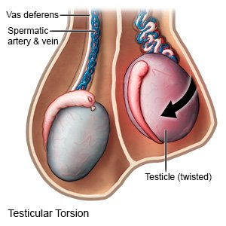
Testicular Torsion
Rare condition in small animals
Torsion of a testicle is more often associated with an intra-abdominal testicle, possibly because it is more mobile; however, inguinal and scrotal testicular torsions have been reported

Slide 7
Patients affected with testicular torsion can present with vague clinical signs (e.g., anorexia, vomiting, lethargy) or signs typical of an acute abdomen, such as mild to marked abdominal discomfort and shock.
Testicular torsion is an emergency situation and without fast diagnosis lead to death
Diagnostics include abdominal radiography, abdominal ultrasonography, and abdominal exploratory surgery. A palpable intra-abdominal mass may also be found during physical examination

Slide 8
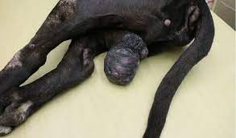
Testicular Neoplasia
Common primary testicular neoplasms include interstitial cell (Leydig) tumors, Sertoli (sustentacular) cell tumors, and seminomas
The mean age of affected dogs range, 3 to 19 years.
Feline testicular tumors are rare, and it is unknown if feline cryptorchid testicles are prone to developing neoplasia

Slide 9
STERILIZATION
Orchiectomy (surgical removal of the testicles). Castration refers to removal of either the male or female sex organs, but it is most commonly used interchangeably for orchiectomy
Indications
1-reduce overpopulation by inhibiting male fertility and decrease undesirable urination behavior.
2-it helps prevent androgen-releated disease, including prostatic diseases, perineal adenomas, and perineal hernia.
3-congenital abnormalities testicular or epididymal abnormalities, scrotal neoplasia, trauma or abscesses.

Slide 10
Nonsurgical Sterilization Techniques
Nonsurgical methods of sterilization in cats and dogs include injections with testosterone and luteinizing hormone–releasing hormone agonist, chlorhexidine digluconate, gonadotropin releasing hormone, glycerol, or zinc gluconate
These techniques can induce azoospermia without inhibiting the development of sexual characteristics
The most common method of nonsurgical chemical sterilization is zinc gluconate testicular injection
The volume injected is based on caliper measurement of the testicle and varies between 0.2 and 1.0 mL/testicle

Slide 11
All methods of chemical sterilization have inconsistent long-term efficacy and can result in adverse side effects such as pain, inflammation, infection, scrotal ulcers or necrosis, scrotal and preputial draining tracts, and testicular necrosis.
Treated animals may have sperm up to 60 days after injection, and some fail to achieve azoospermia and therefore require retreatment.
Because testosterone is still present, associated behaviors and disease conditions such as perineal hernias, perianal adenomas, and Benign prostatic hyperplasia (BPH) are not eliminated

Slide 12
SURGICAL TECHNIQUES(Canine Orchiectomy)
Can be performed with an open or closed technique.
Closed technique, the parietal vaginal tunic is left intact.
Open technique, the parietal vaginal tunic is incised, penetrating the potential peritoneal space below.
In both techniques, scrotal ablation is usually not required because the scrotum will usually regress sufficiently.

Slide 13
The scrotum in dogs is thin, pigmented, and covered with finely scattered hairs while in cats is densely haired
It composed of three layers: the skin, tunica dartos, and scrotal fascia. The tunica dartos is a poorly developed layer of smooth muscle mixed with collagenous and elastic fibers that lies deep to the skin. The testes are able to be drawn closer to the body when the tunica dartos contracts
The scrotum is divided into two cavities by a median septum composed of fascia and tunica dartos
Within each scrotal sac is an evaginated pouch of peritoneum called the vaginal process, which is covered by the external and internal spermatic fascia.
The external pudendal artery is the principal blood
vessel to the scrotum

Slide 14
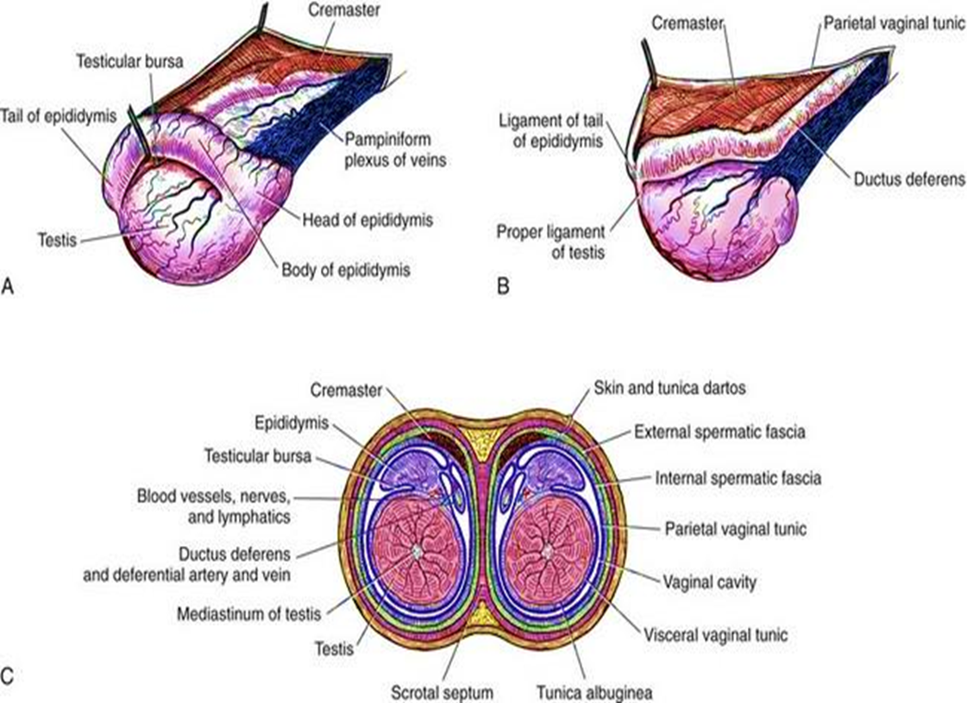

Slide 15
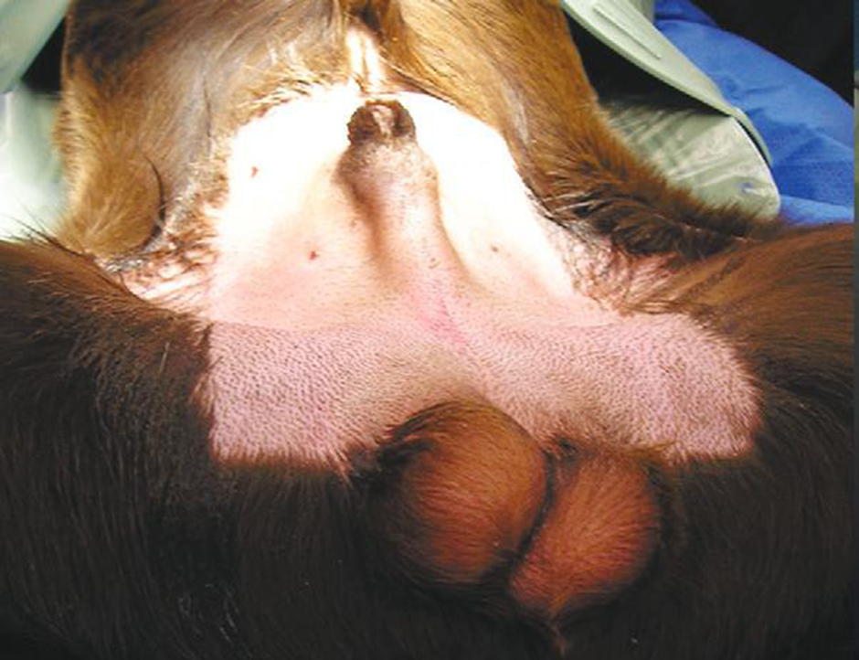
Castration technique
In both open and closed castration techniques, The canine patient is placed in ventral recumbency
The prescrotal area is clipped and surgically prepared; the scrotum is not shaved to avoid scrotal irritation
Long scrotal hairs can be cut short
The scrotum can be moistened with
antiseptic solution before
draping to keep hairs away
from the prescrotal region

Slide 16
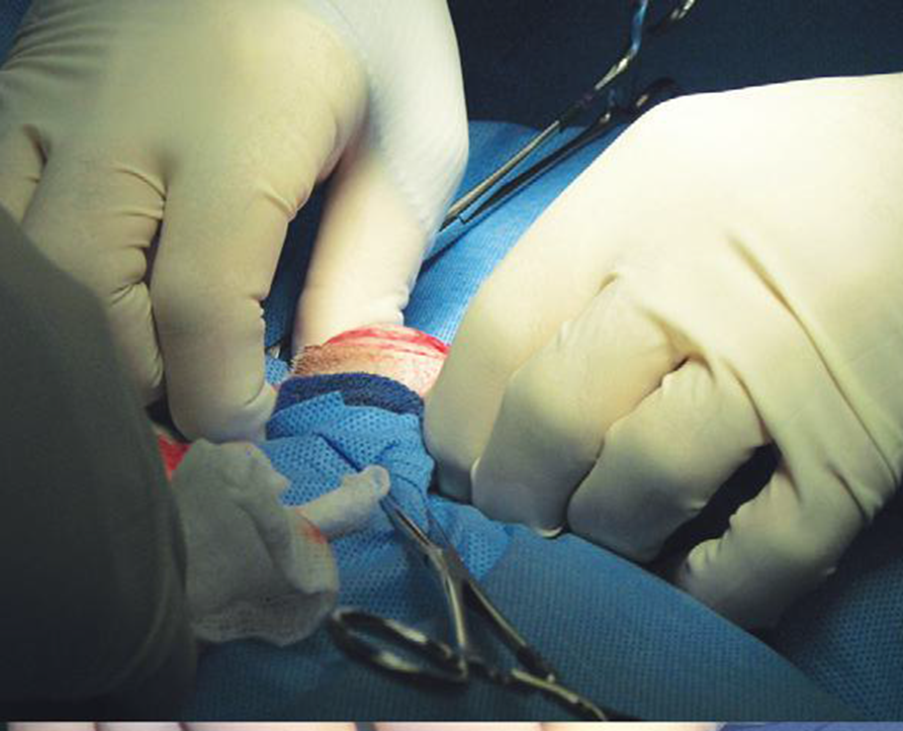
Both the open and closed techniques use a midline prescrotal incision, with care taken to not extend the caudal part of the incision onto the scrotum
Pressure is applied through the drape to the scrotum to push the testicle cranially

Slide 17
A prescrotal skin incision is made directly over the testicle to avoid inadvertent iatrogenic urethra damage
The subcutaneous tissue and spermatic fascia are sharply incised over the testis to expose the parietal vaginal tunic.
The testis can then be exteriorized
Scrotal fat and fascia are stripped from the parietal vaginal tunic with a gauze sponge to provide maximal testicle exteriorization

Slide 18
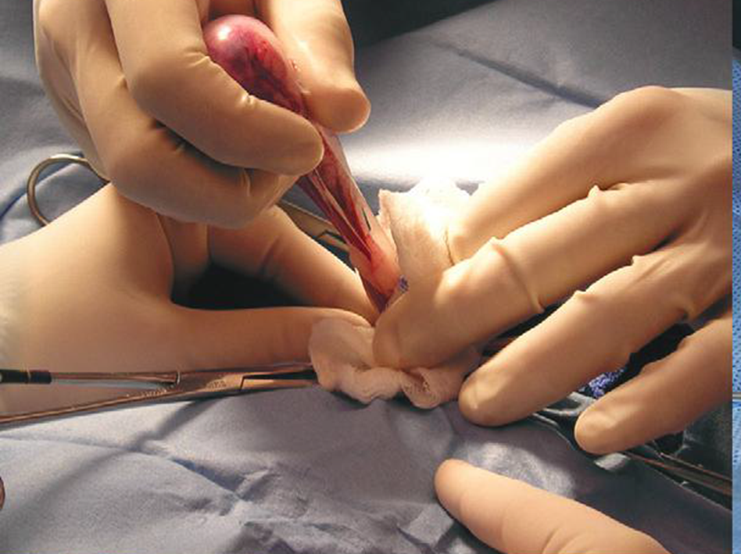
Fat and spermatic fascia are stripped from the spermatic cord.

Slide 19
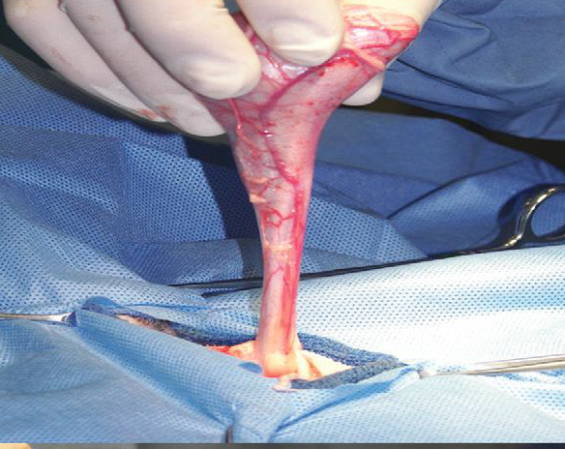
Stripped spermatic cord

Slide 20
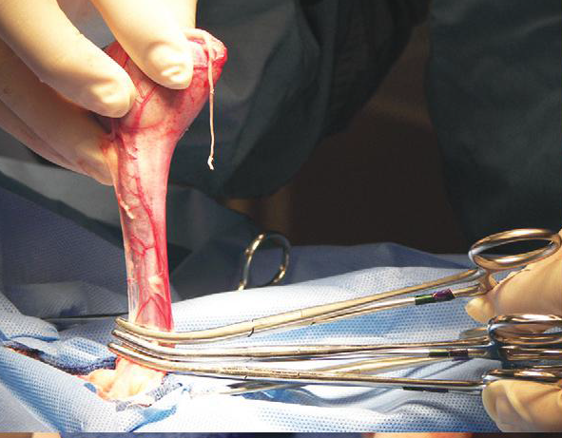
Three clamps are applied to the spermatic cord

Slide 21
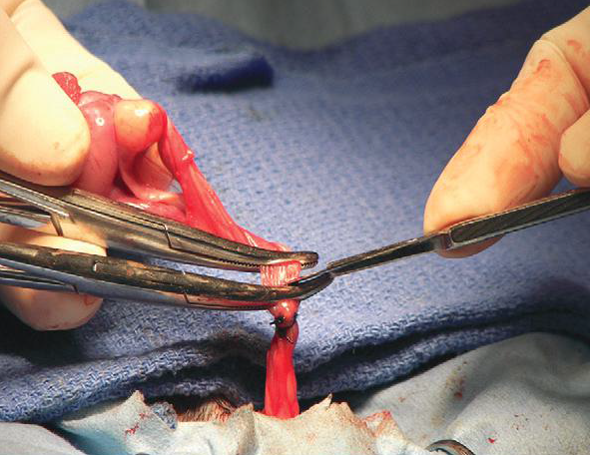
After two ligatures have been placed (as described in text), the spermatic cord is cut between clamps.

Slide 22
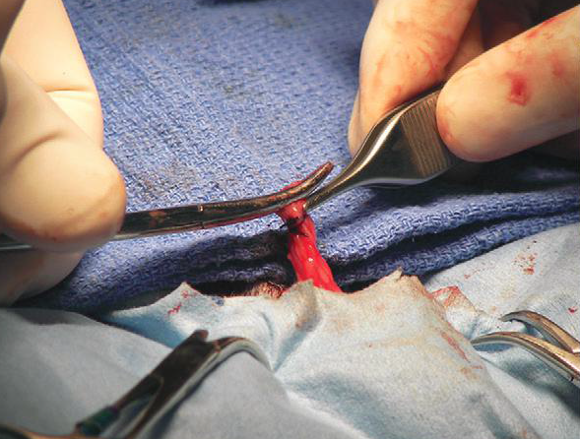
Before releasing the clamp, the stump is grasped with thumb forceps

Slide 23
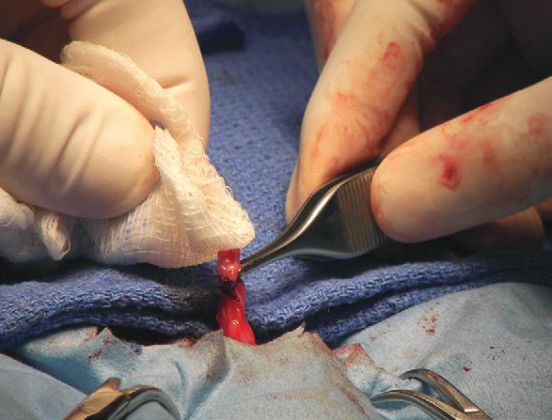
The stump is checked for hemorrhage before releasing

Slide 24
Open prescrotal castration
Incise the parietal vaginal tunic over the testicle
Do not incise the tunica albuginea because this would expose the testicular parenchyma
Place a hemostat across the vaginal tunic where it attaches to the epididymis.
. Digitally separate the ligament of the tail of the epididymis from the tunic while applying traction with the hemostat on the tunic
Further exteriorize the testicle by applying caudal and outward traction. Identify the structures of the spermatic cord. Individually ligate the vascular cord and ductus deferens, then place an encircling ligature around both. Many surgeons ligate the ductus deferens and pampiniform plexus together

Slide 25
Use 2-0 or 3-0 absorbable suture (e.g., polyglactin 910 [Vicryl], polydioxanone [PDS], poliglecaprone 25 [Monocryl], polyglyconate [Maxon], or glycomer 631 [Biosyn]) for ligatures
Advance the second testicle into the incision, incise the fascial covering, and remove the testicle as described
Appose the incised dense fascia on either side of the penis with interrupted or continuous sutures. Close subcutaneous tissue with a continuous pattern. Appose skin with an intradermal, subcuticular, or simple interrupted suture pattern.

Slide 26
Open castration
The parietal vaginal tunic is incised over the testicle

Slide 27
Open castration
Metzenbaum scissors are used to extend the incision through the parietal vaginal tunic

Slide 28
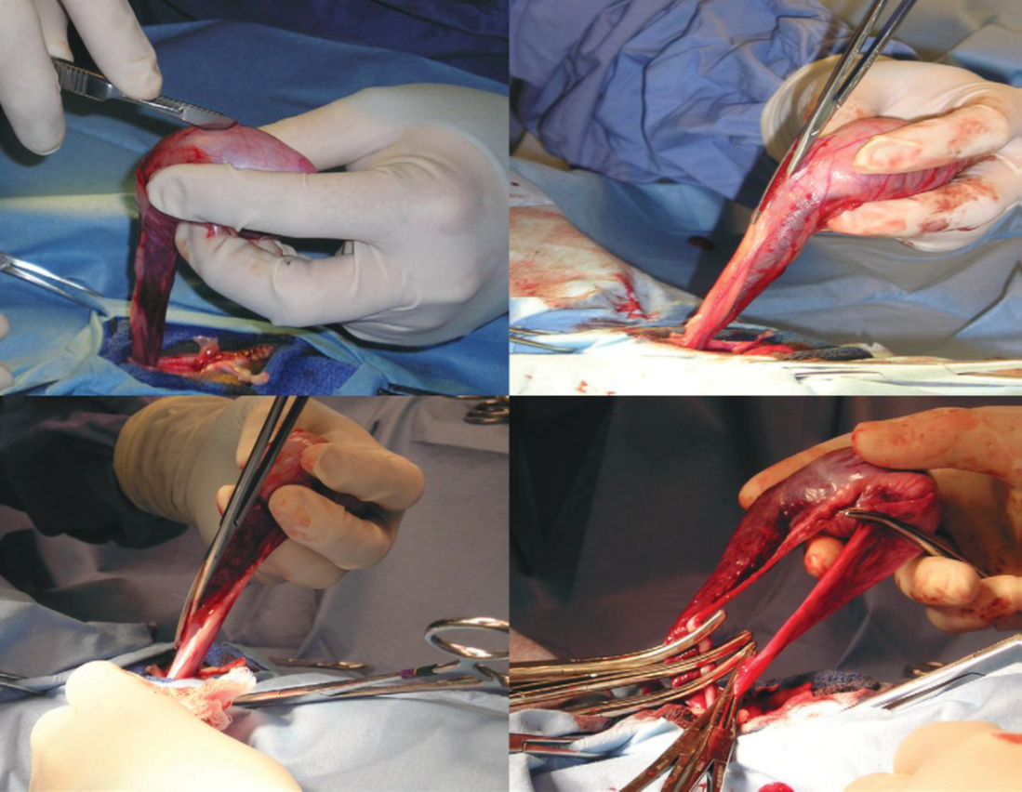
Open castration
The incision has been extended through the parietal vaginal tunic.

Slide 29
Open castration
The parietal tunic, cremaster muscle, and ductus deferens and its vessels are separated from the spermatic vascular cord (testicular artery, nerve, and pampiniform plexus). Clamps are applied to each section

Slide 30
Feline Orchiectomy
Cats can be positioned in dorsal or lateral recumbency with the hindlimbs pulled forward.
The hair over the scrotal sac is plucked free of hair

Slide 31
Feline Orchiectomy
The scrotum is draped within the surgical field. The testicle is immobilized within the scrotum, and the overlying skin is incised. The incision should be parallel to the scrotal median septum and about half the distance from the septum and the lateral aspect of the scrotum

Slide 32
Feline Orchiectomy
The testis is pushed through the scrotal incision
Testicle is being exteriorized
For prepubertal castrations, the spermatic cord should be pulled cautiously because it cannot be exteriorized as far and may be more fragile
Cord ligation is performed with an overhand hemostat technique, figure of eight hemostat technique, suture or hemoclip attenuation or square knot open technique
The cord is transected 2 to 6 mm distal to the ligation site and evaluated for hemorrhage

Slide 33
Feline Orchiectomy
The remaining testicle is approached through a second skin incision, and the process is repeated. Scrotal skin incisions are left open to heal by second intention
Ideally, patients should have their activity restricted for 3 to 7 days, and an Elizabethan collar should be placed on patients interested in licking their incisions.
Analgesics such as NSAIDs and opioid or opioid-like (tramadol) drugs should be prescribed

Slide 34
FelineSpermatic cord ligation techniques
Overhand Hemostat and Figure of Eight Hemostat Techniques:-
Overhand and figure of eight techniques are performed with Halsted mosquito hemostatic forceps
Some veterinarians believe that the figure of eight knot is more secure than the overhand knot; however, it may be more difficult to slide the knot over the hemostat. For both techniques, the spermatic cord

Slide 35
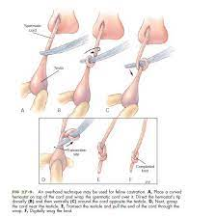
Overhand Hemostat and Figure of Eight Hemostat Techniques
For both techniques, the spermatic cord should be wrapped around the hemostat close to the tips and to the scrotum
Before hemostat release, the knot is tightened by placing traction between the knot and the hemostat

Slide 36
2- Ligation Technique
Two circumferential ligatures are placed around the distal spermatic cord using 3-0 or 4-0 monofilament absorbablesuture.
A two- or three-clamp technique can be used if necessary.
Alternatively, two appropriately sized hemoclips can be placed on each spermatic cord.

Slide 37
3- Square Knot Technique
The square knot technique is an open castration
The vaginal tunic, its associated cremaster muscle, and the ductus deferens and its associated vessels are separated from the spermatic vascular cord (testicular artery, nerve, and pampiniform plexus) , resulting in two separate structures.
These two structures are tied together with two or three square knots (four to six throws), and the spermatic cord is transected distally
Failure of this technique occurs when slip knots are placed instead of square knots

